Slide 1
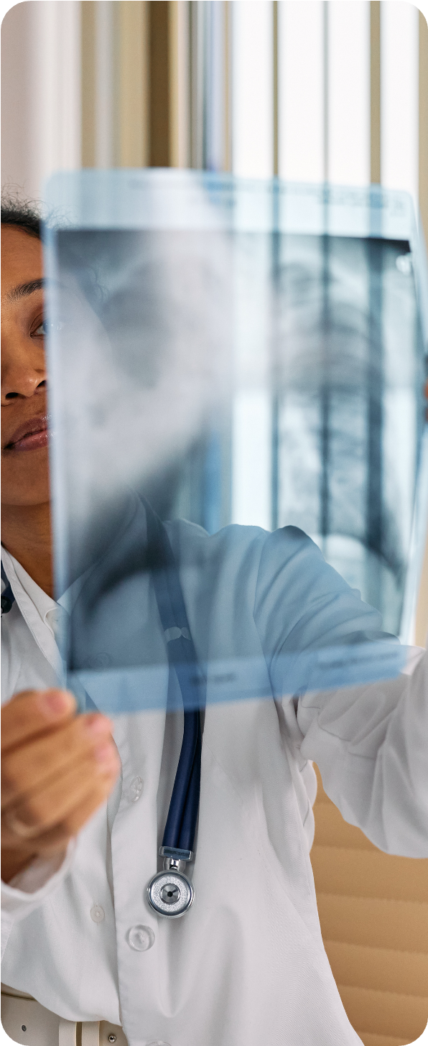

Project
MediScan
By: Mahin S

Slide 2
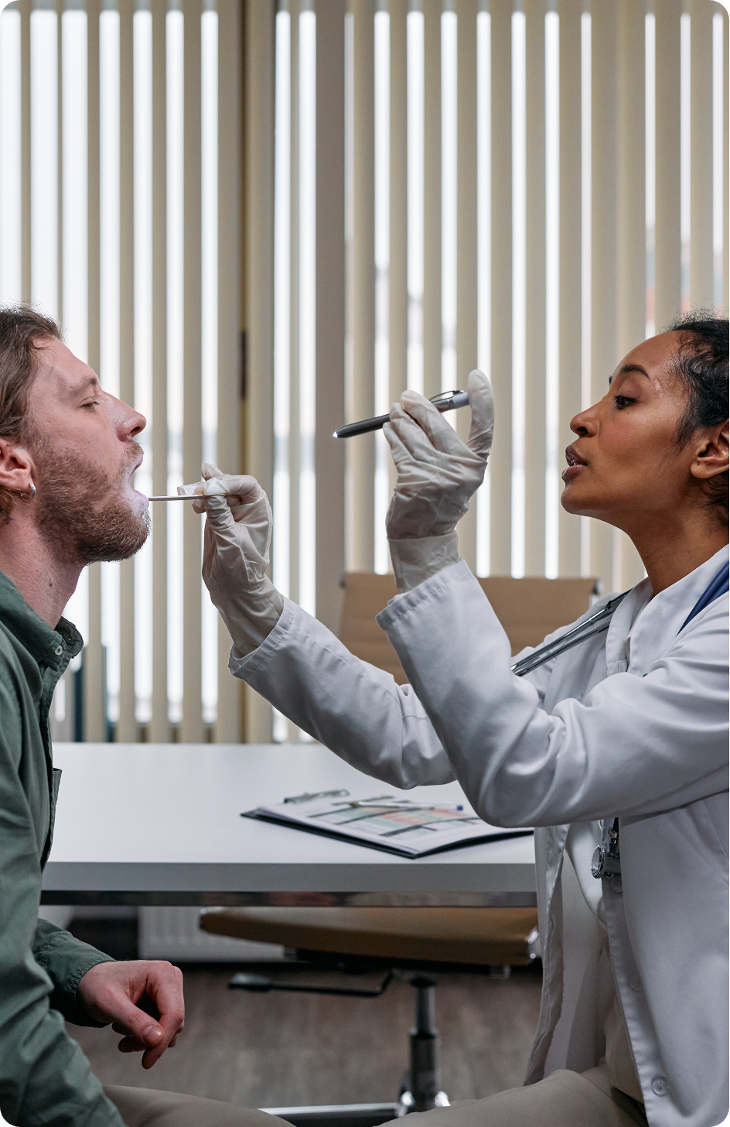

Overview
Project Overview
What is OCR?
Technologies Used
Workflow
Limitations and Future enhancements

Slide 3
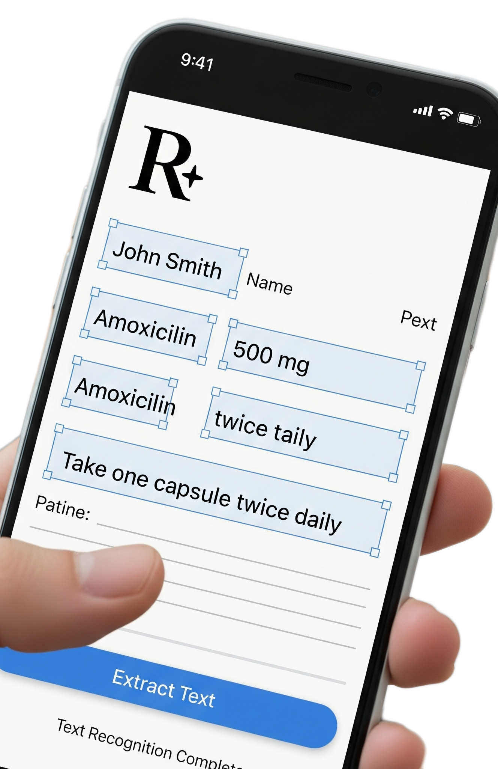
About the Project
In hospitals, pharmacies, and health insurance companies handle thousands of documents daily ranging from prescriptions to diagnostic reports.
This project can be implemented in hospital management systems or insurance claim processing pipelines to automatically extract relevant information and store it in structured databases.
The Medical Data Extraction system addresses this problem by combining OCR and Natural Language Processing techniques to automate data entry and record management. This reduces administrative workload, enhances accuracy, and makes patient data easily accessible for analytics or digital record systems.
This reduces administrative workload, enhances accuracy, and makes patient data easily accessible for analytics or digital record systems.

Slide 4
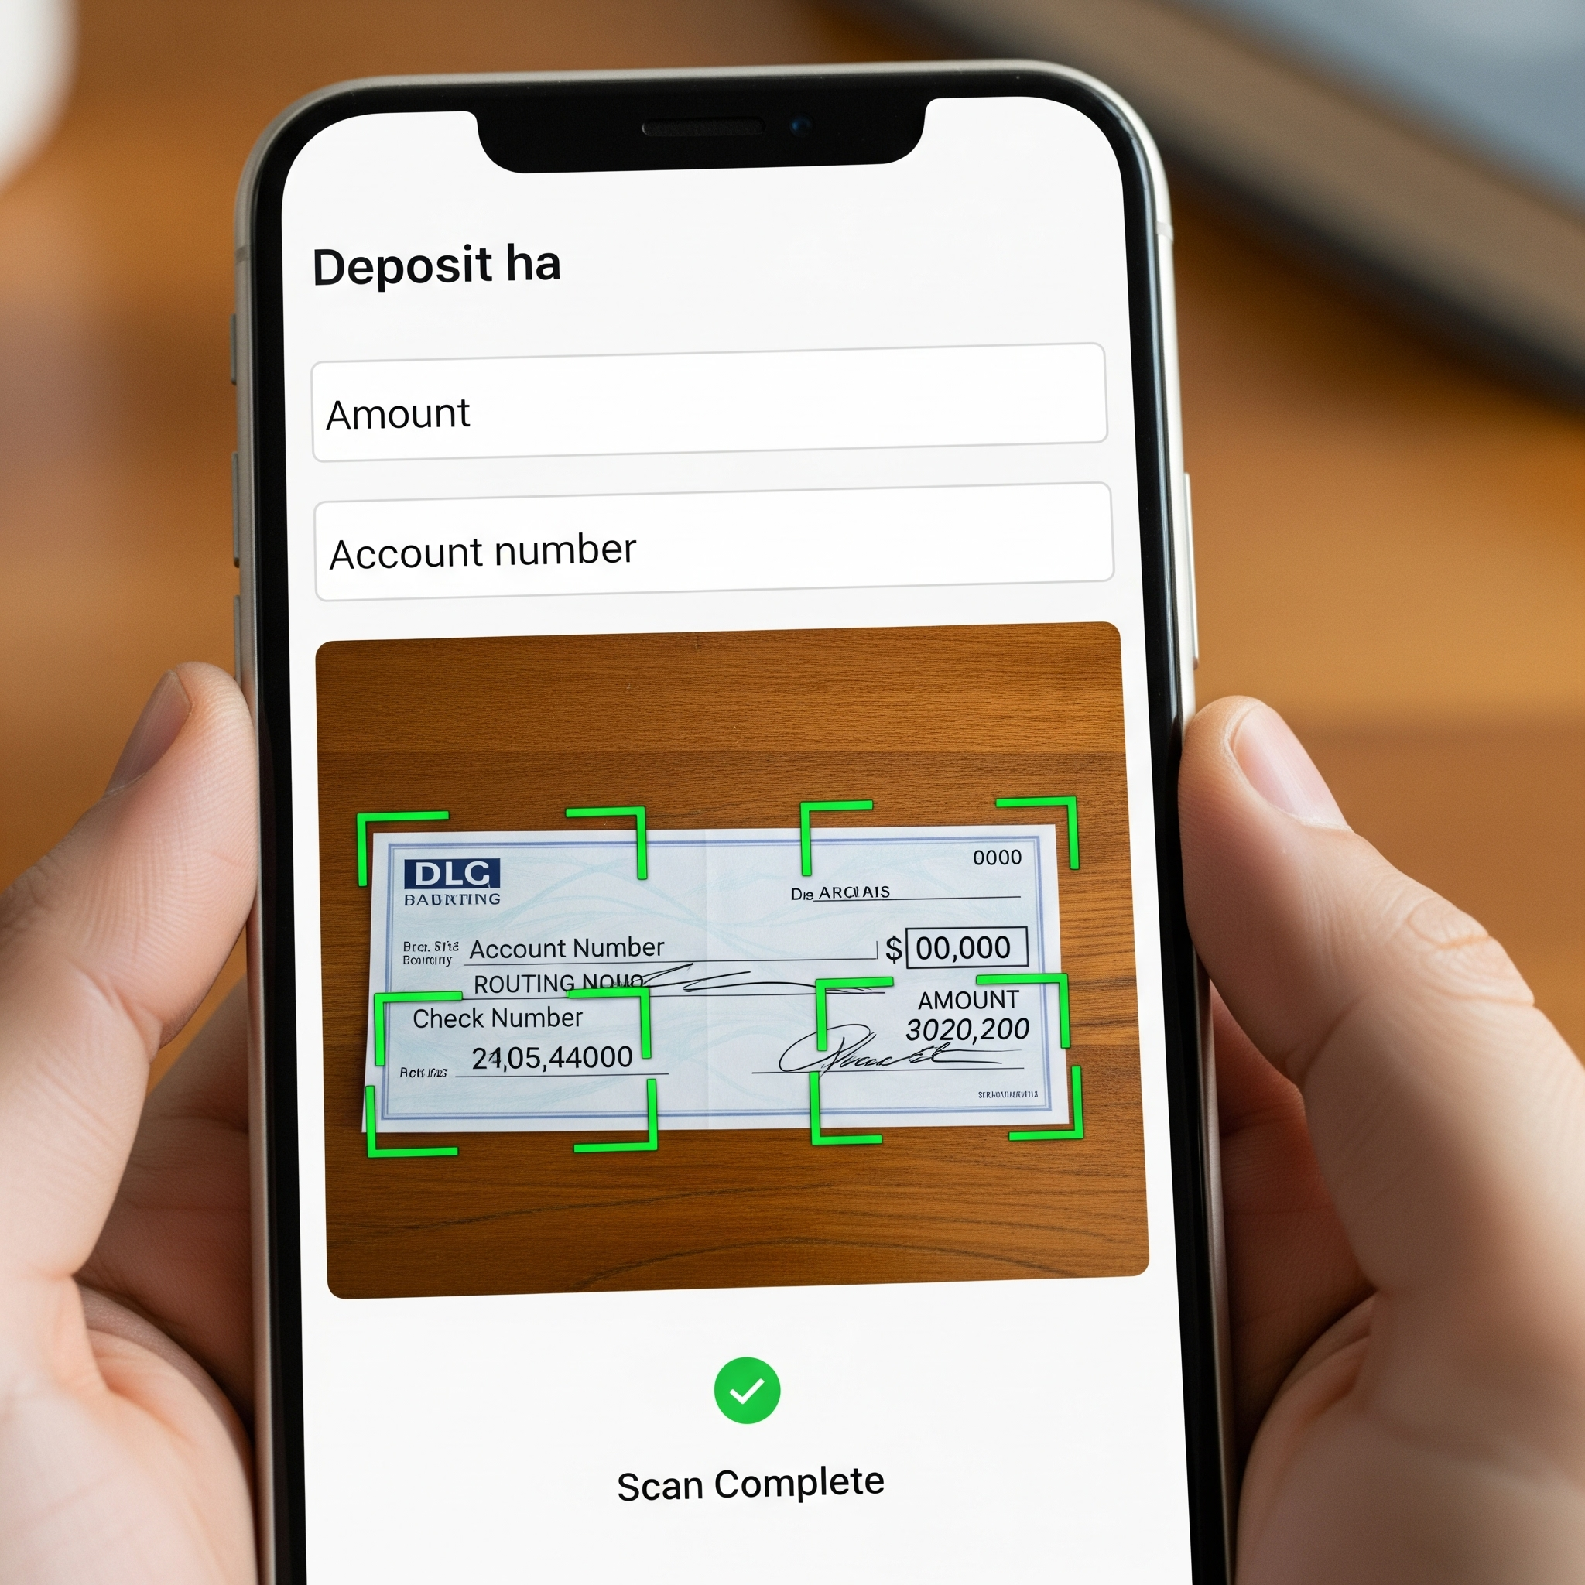

Optical Character Recognition (OCR) is a technology that allows computers to read and extract text from images or scanned documents such as printed pages, receipts, or handwritten notes.
OCR technology is widely used in various domains such as document digitization, data extraction from receipts and invoices, identity verification, and even vehicle license plate recognition.
What is OCR?

Slide 5
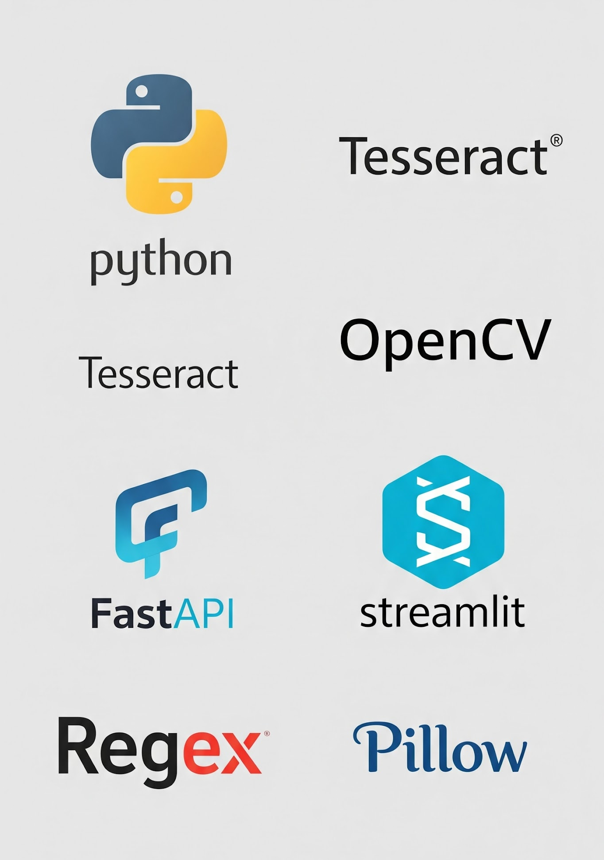

Technologies used
Python – Core programming language used for data extraction and backend logic.
OpenCV – Used for image preprocessing like thresholding and binarization.
Tesseract OCR – Extracts readable text from scanned medical documents.
RegEx (Regular Expressions) – Helps identify and extract key fields from the OCR text.
FastAPI – Backend framework for processing PDF uploads and returning extracted data as JSON.
Streamlit – Frontend web app for uploading PDFs and displaying extracted results.
Pillow – Image-handling library used for converting and saving image formats.
Uvicorn – ASGI server used to run the FastAPI backend efficiently.
python-multipart – Handles file uploads in FastAPI requests.

Slide 6
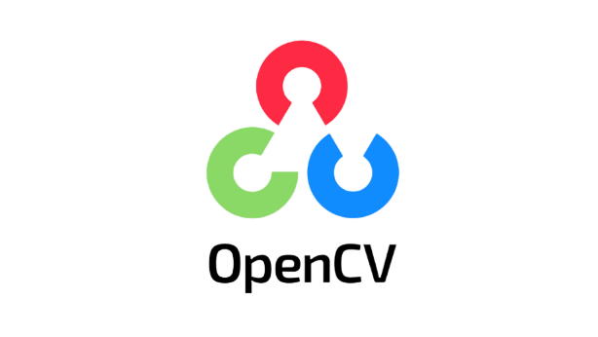
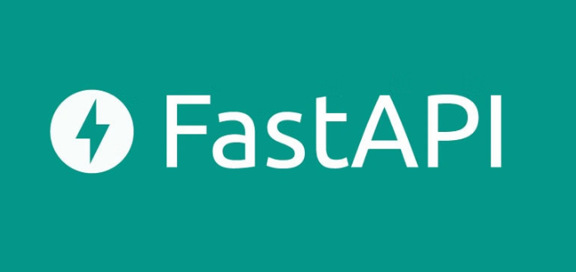
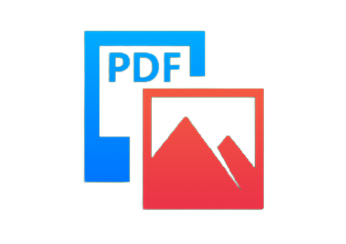
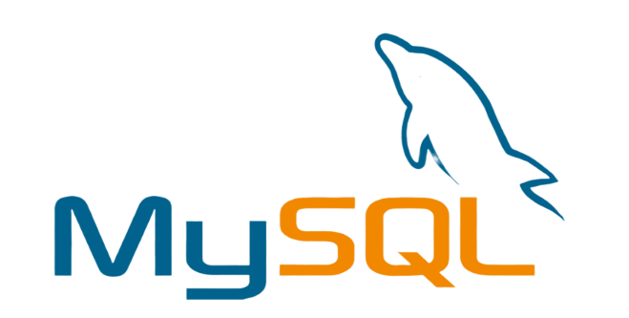
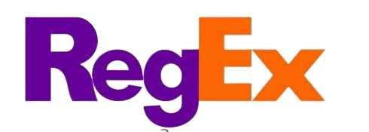
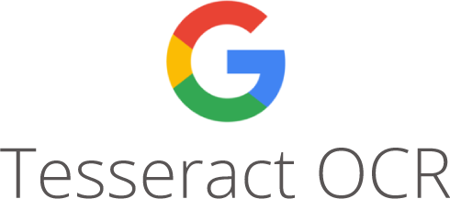
Workflow
FastAPI backend receives a PDF prescription/patient _data file through Streamlit frontend
The image is cleaned and enhanced using OpenCV to make the text clearer for OCR
Convert PDF to Image using pdf2image
Specific data like patient name, address, medicines etc are identified and structured using RegEx patterns.
The extracted and structured information is stored in MySQL Database
Google Tesseract reads the preprocessed image and extracts all the text content

Slide 7


Limitations
Inconsistent Accuracy with Handwritten Text
The system currently works best with English and structured document formats; it may fail with multi-language or unstructured medical reports.
No Real-Time Integration
Future Enhancements
Connect MediScan with healthcare systems (like EMR/EHR) for automatic patient record updates and seamless medical data flow.
Implement deep learning models to better interpret handwriting, medical terminology, and context for higher accuracy.
Multi-language & Cloud Deployment Support

Slide 8
This presentation template is free for everyone to use, thanks to the following:
Thank You

